Slide 1

Shell Bootcamp 2024 3 Reflections for Week 1
Shobhit Agrawal
Date : 30-Aug-2024

Slide 2

About Me
Embrace Growth, Achieve Excellence

Slide 3

My learnings from this week!

Slide 4
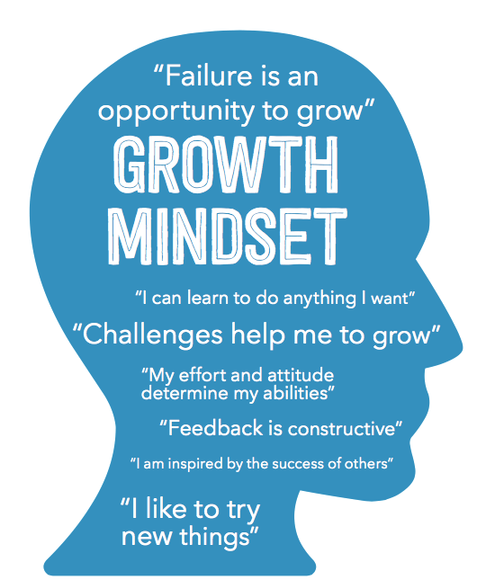
Learning 1 | My takeaways
Growth Mindset
A growth mindset sees intelligence and talents as qualities that can be developed through dedication and hard work
Implementing a growth mindset in the energy sector drives innovation and efficiency by encouraging continuous learning. This leads to advancements in renewable energy, smart grids, and energy storage solutions.

Slide 5
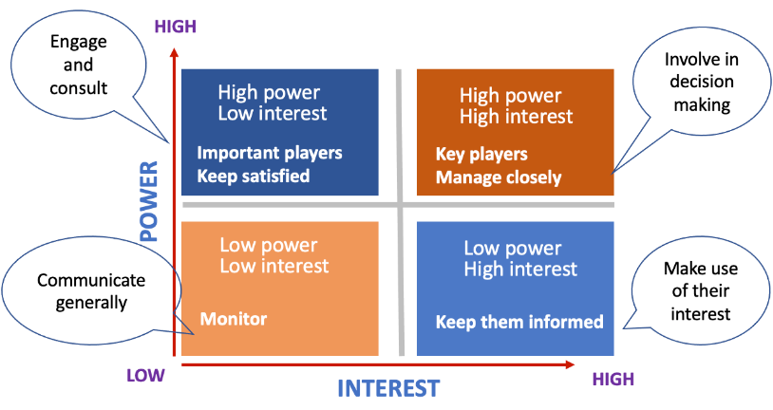
Learning 2 | My takeaways
Power Interest Grid
Prioritize stakeholders with high power and high interest by closely managing their expectations, while keeping those with high power but low interest.
High-power, high-interest stakeholders like government regulators and major investors should be closely managed to ensure their support and alignment with project goals.

Slide 6
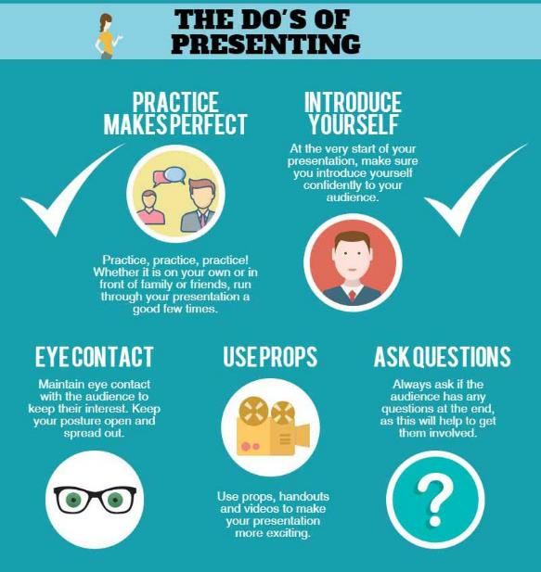
Learning 3 | My takeaways
Elements of an effective presentation
Audience Analysis, Content, Design, Delivery
In the energy sector, effective presentations involve tailoring content to stakeholders, using clear and professional slides, and delivering messages persuasively to ensure understanding and support for projects. This approach enhances communication and project success.

Slide 7
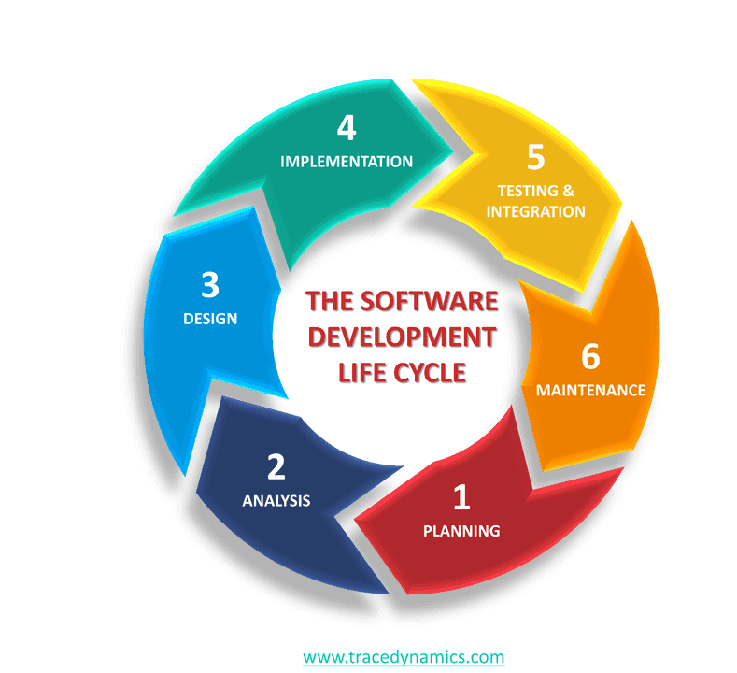
Learning 4 | My takeaways
Software Development Life Cycle (SDLC)
It is a structured process that ensures high-quality software by following stages like Initial, Analysis, Design, Coding, Testing and Delivery & Maintenance. It helps manage project scope, time, and cost effectively.
In the energy sector, SDLC is used to develop and maintain smart grid technologies, manage renewable energy projects, and create energy management systems. It ensures efficient energy distribution, optimizes usage, and enhances reliability through predictive maintenance.

Slide 8
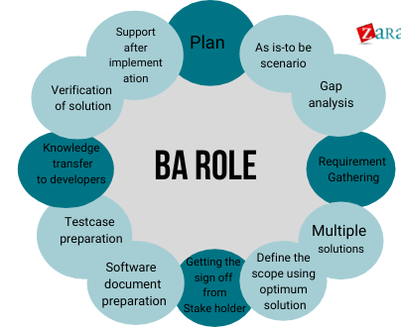
Learning 5 | My takeaways
Functions of Business Analyst (BA)
Define and scope of business areas, Elicit Requirements, Analysis and documentation requirements, Communicate Requirements, Identify Solution, and verify if solution meets the requirements
In the energy sector, business analysts monitor market trends and regulatory changes, assess the feasibility of renewable energy projects, and optimize energy usage. They ensure alignment between business strategies and operational goals, enhancing efficiency and sustainability

Slide 9
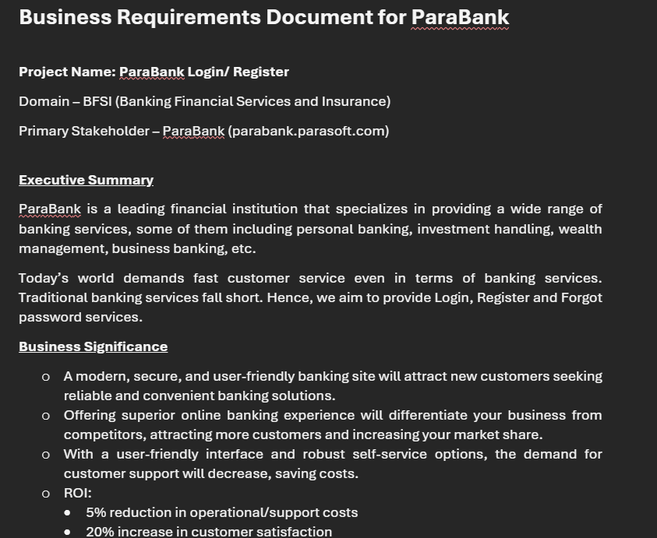
Learning 6 | My takeaways
Business Requirements Document (BRD)
BRD ensures all stakeholders understand project goals and scope, identifies potential risks early, and serves as a roadmap for project success. It enhances communication and alignment with business objectives.
In the energy sector, it is used to clearly define project goals and requirements for renewable energy projects, smart grid technologies, and energy management systems. It ensures alignment among stakeholders, identifies potential risks, and guides the project to successful completion.

Slide 10
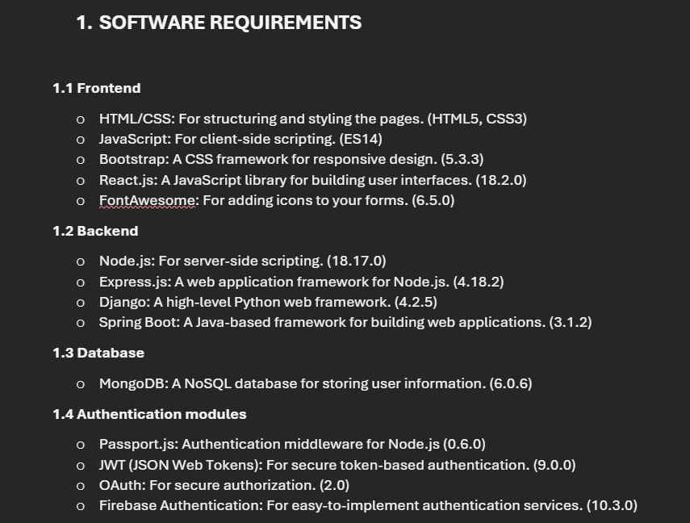
Learning 7 | My takeaways
Software Requirements Specifications Document (SRS)
SRS document serves as a blueprint for software development, detailing both functional and non-functional requirements. It ensures clear communication among stakeholders, guides the development process, and helps prevent project scope creep and misunderstandings.
It is used to define the functional and non-functional requirements for developing smart grid technologies, renewable energy systems, and energy management software.

Slide 11

Relevance of learnings for my organization

Slide 12
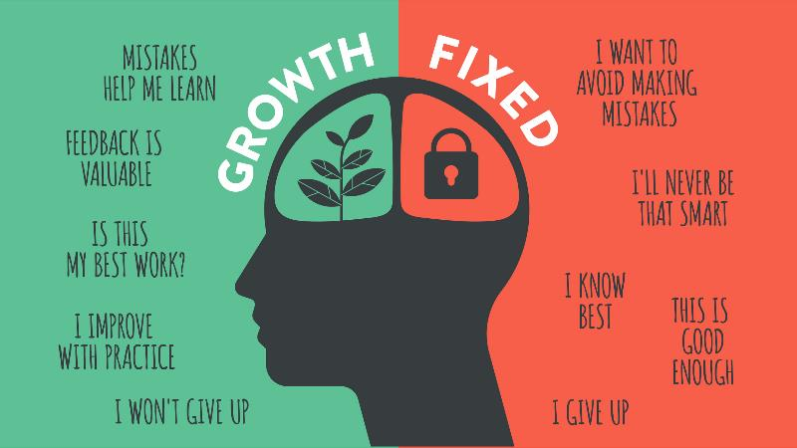
Learning 1 | Relevance for Shell
Shell fosters a growth mindset by encouraging continuous learning and innovation among employees, promoting a culture where challenges are embraced and failures are seen as opportunities for growth.
By adopting a growth mindset, Shell enhances its adaptability and problem-solving capabilities, leading to greater innovation and resilience in a rapidly evolving energy sector.

Slide 13
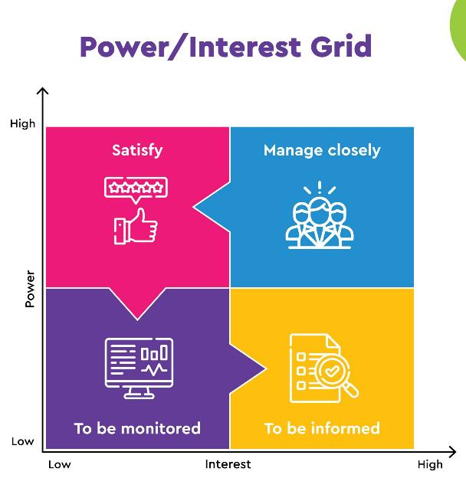
Learning 2 | Relevance for Shell
Shell uses the Power-Interest Grid to strategically manage stakeholders by identifying their level of influence and interest, ensuring that key stakeholders are engaged and their needs are addressed effectively.
By applying the Power-Interest Grid, Shell can prioritize resources and communication efforts, leading to better stakeholder relationships, smoother project execution, and enhanced support for its initiatives.

Slide 14
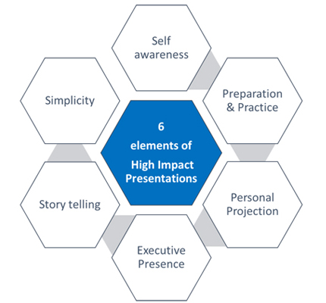
Learning 3 | Relevance for Shell
Shell likely implements the elements of an effective presentation by thoroughly analyzing their audience, organizing well-researched content, designing clear and professional slides, and delivering messages persuasively to ensure clarity and engagement.
By mastering effective presentation skills, Shell can communicate complex information more clearly, foster better stakeholder relationships, and drive successful project approvals and collaborations.

Slide 15
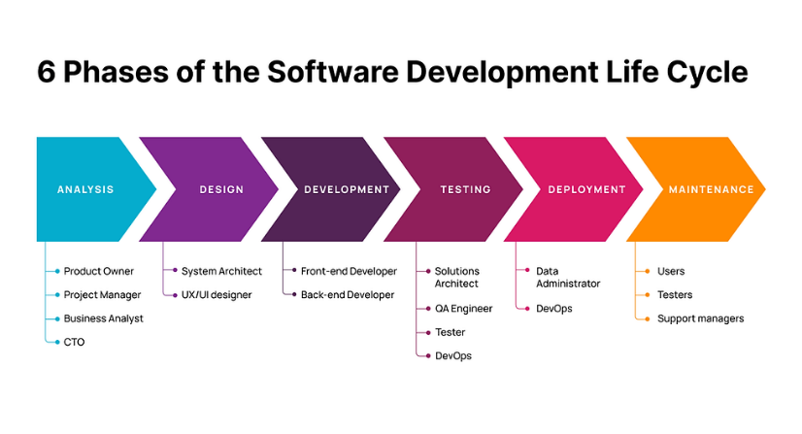
Learning 4 | Relevance for Shell
Shell integrates learning into its SDLC by continuously updating best practices and incorporating feedback loops to enhance software quality and efficiency.
This approach leads to improved project outcomes, reduced errors, and increased innovation, ultimately driving better business performance and customer satisfaction.

Slide 16
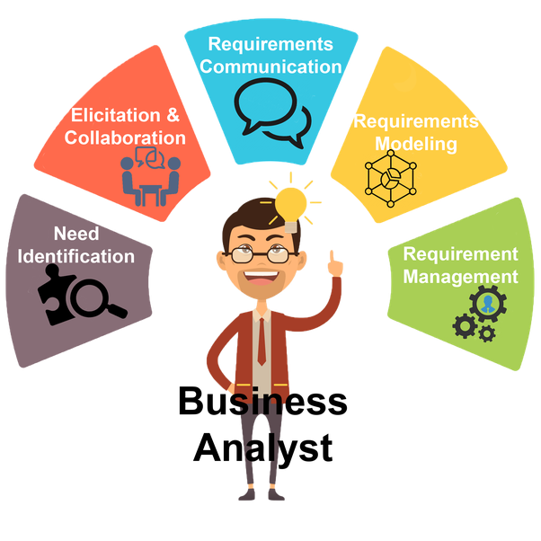
Learning 5 | Relevance for Shell
Shell leverages the expertise of business analysts to gather and analyze requirements, ensuring that the SDLC aligns with business goals and stakeholder needs.
This results in more accurate project scopes, better alignment with business objectives, and enhanced stakeholder satisfaction, leading to successful project delivery and optimized resource utilization.

Slide 17
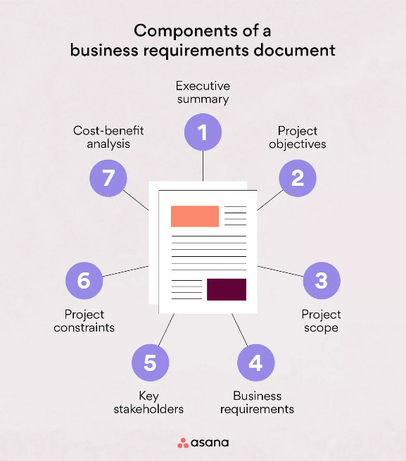
Learning 6 | Relevance for Shell
Shell meticulously crafts Business Requirements Documents (BRDs) to clearly define project objectives, scope, and stakeholder expectations, ensuring alignment throughout the SDLC.
This practice leads to more structured and efficient project execution, minimizes misunderstandings, and enhances overall project success by providing a clear roadmap for development teams.

Slide 18
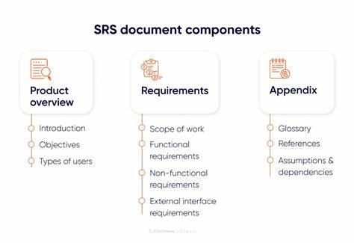
Learning 7 | Relevance for Shell
Shell integrates this learning by continuously updating its software requirements specifications (SRS) to reflect the latest industry standards and best practices. This ensures that their software solutions remain robust, efficient, and aligned with business goals.
By implementing this learning, Shell enhances its operational efficiency and reduces the risk of software failures. This leads to improved project outcomes, cost savings, and a stronger competitive edge in the market.

Slide 19

Challenges in implementing learning

Slide 20
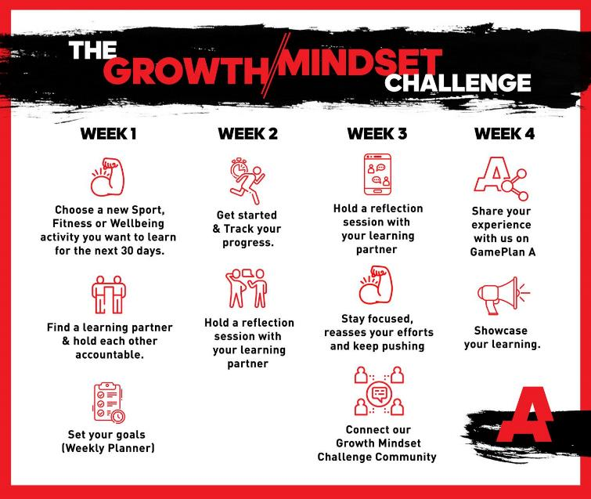
Challenge faced while implementing Learning 1
Challenges Faced: Implementing a growth mindset can be difficult due to ingrained habits and fear of failure. Overcoming resistance to change and maintaining motivation during setbacks are common hurdles.
Plan to Overcome: To address these challenges, I plan to set small, achievable goals to build confidence, seek feedback to improve continuously, and cultivate a supportive environment that encourages learning and resilience. This approach will help in gradually shifting towards a growth mindset.
GitHub link of your solution/documentation

Slide 21
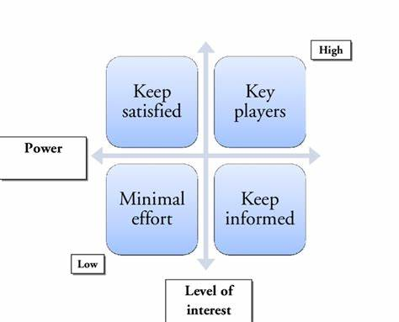
Challenge faced while implementing Learning 2
Challenges Faced: Implementing the Power-Interest Grid can be challenging due to the dynamic nature of stakeholder interests and power. Accurately identifying and categorizing stakeholders and managing conflicting interests can be difficult.
Plan to Overcome: To address these challenges, I plan to regularly update stakeholder analysis, engage in continuous communication to understand their evolving interests, and develop strategies to balance conflicting priorities. This approach will help in effectively managing stakeholders and ensuring project success.
GitHub link of your solution/documentation

Slide 22
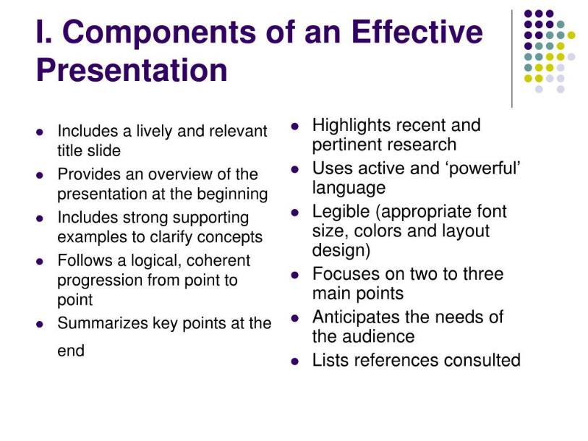
Challenge faced while implementing Learning 3
Challenges Faced: Creating effective presentations can be challenging due to the need for thorough audience analysis, organizing complex content, designing visually appealing slides, and delivering the message confidently. Balancing all these elements can be overwhelming.
Plan to Overcome: To address these challenges, I plan to invest time in understanding my audience, use structured templates for organizing content, seek feedback on slide design, and practice delivery to build confidence.
GitHub link of your solution/documentation

Slide 23
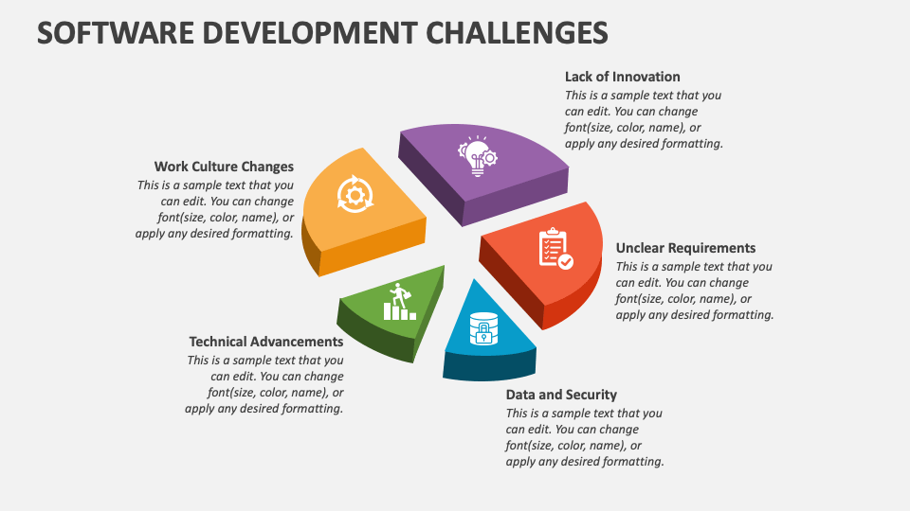
Challenge faced while implementing Learning 4
Challenges Faced:
Integrating new SDLC processes into existing workflows.
Resistance to change from team members.
Plans to Overcome:
Provide detailed training and documentation.
Engage in open discussions and involve team members in planning.
Implement peer reviews and automated testing for quality assurance.

Slide 24
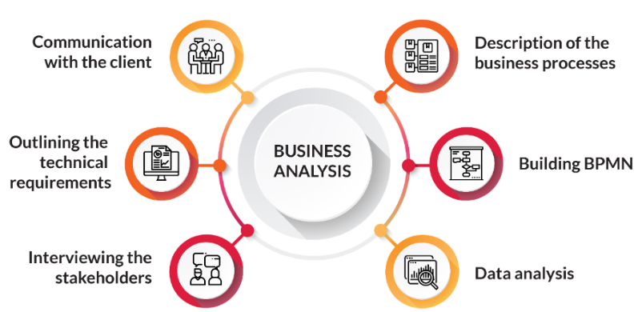
Challenge faced while implementing Learning 5
Challenges Faced:
Balancing stakeholder expectations with project constraints.
Managing large volumes of data for accurate analysis.
Ensuring clear communication across diverse teams.
Plans to Overcome:
Set realistic expectations and maintain transparent communication.
Foster regular meetings and use collaboration platforms for clarity.

Slide 25
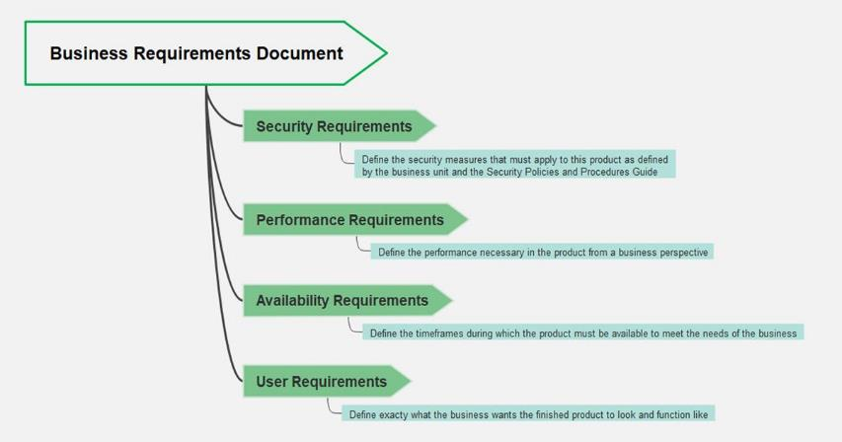
Challenge faced while implementing Learning 6
Challenges Faced:
Ensuring all stakeholder requirements are accurately captured and documented.
Managing changes and updates to the BRD throughout the project lifecycle.
Aligning the BRD with technical constraints and project scope.
Plans to Overcome:
Implement a robust change management process for updates.
Collaborate closely with technical teams to ensure alignment.

Slide 26
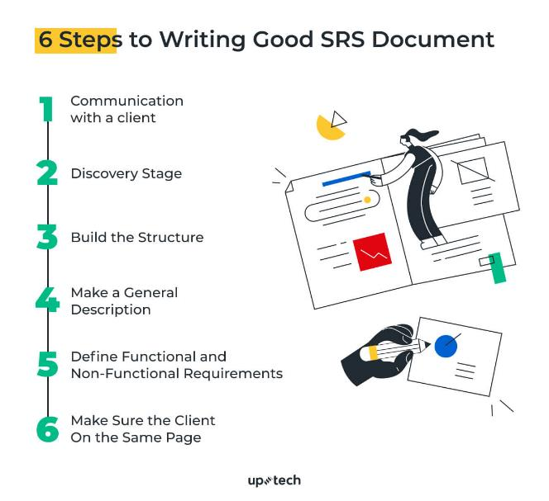
Challenge faced while implementing Learning 7
Challenges:
Understanding and clarifying vague or conflicting requirements from stakeholders.
Managing changes and additions to the project scope during the documentation process.
Plans to Overcome:
Conduct regular meetings with stakeholders to clarify requirements and ensure alignment.
Implement a change control process to evaluate and approve any changes to the project scope.

Slide 27

Action Plan

Slide 28
My Action Plan for this Week
Actions
Timeline
Status
Practicing and learning all my learnings including:
Growth Mindset Power Interest Grid Effective Elements of a presentation SDLC, Functions of BA BRD, and SRS
I am thinking of following the below timeline:
Saturday – Brush up on all my key learnings including Soft Skills and 2 days technical training Sunday – Make short notes on all of them
I think that the status will be complete by the end of the week for all my learnings

Slide 29

Learning is also Fun!

Slide 30
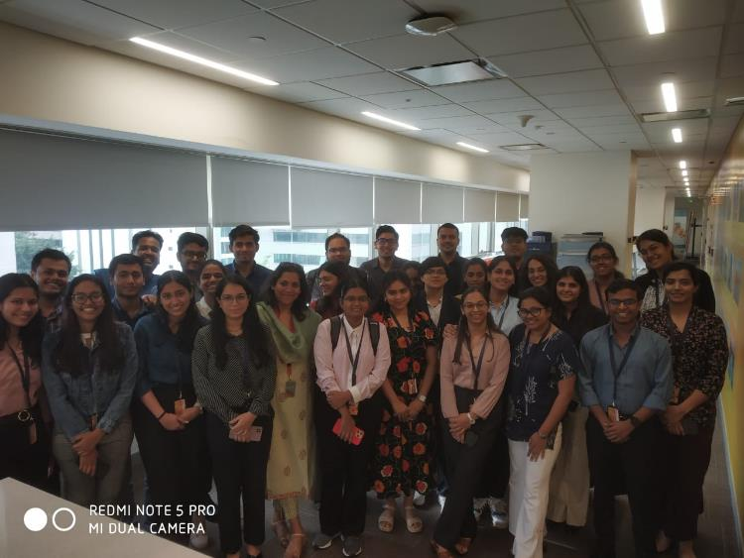
Learning is also Fun!
Nitya ma’am explained each concept in a very informative manner and was very clear in explaining everything. She conducted so many group activities as were very sleepy during the classes because of theoretical concepts. She gave us breaks without any hesitation and we enjoyed her sessions very much. Mohammed Suhail Abbasi sir is a perfect example of how interactive learning is done. He is very good in teaching concepts; he gives us real life examples for each concept and motivates us for doing well in our life and make our parents proud.

Slide 31

Summary
Learned very effectively all my key learnings including Growth Mindset, Power Interest Grid, Effective elements of a presentation, Software Development Life Cycle (SDLC), and models of SDLC. I think that I will remember these concepts and apply them in my personal as well as professional life.
The upcoming topics includes Scrum Agile model of SDLC, practical hands-on on the Azure DevOps, Testing etc… which I think are very important for the role I am going to play in the organization as a Software Engineer. These concepts will help me in developing my knowledge in the field of software engineering and implement these in my professional career.
The topics from the current week like SDLC, BRD, SRS, models of SDLC, functions of Business Analyst, BRD, SRS, all these topics are the foundation of the topics that will be upcoming in the next week as all of them are related to Software Engineering.

Slide 32
Thank You

